Slide 1
Accessing the Curriculum for Diverse Learners
Numeracy Development cont’d

Slide 2
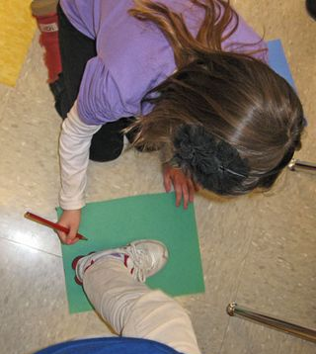
Activity: How big is your foot?
Work in pairs.
Trace each other’s foot on large piece of paper.
Estimate the number of paper clips needed to outline your foot. Record.
Measure your foot using paper clips.
Record the actual measurement.

Slide 3
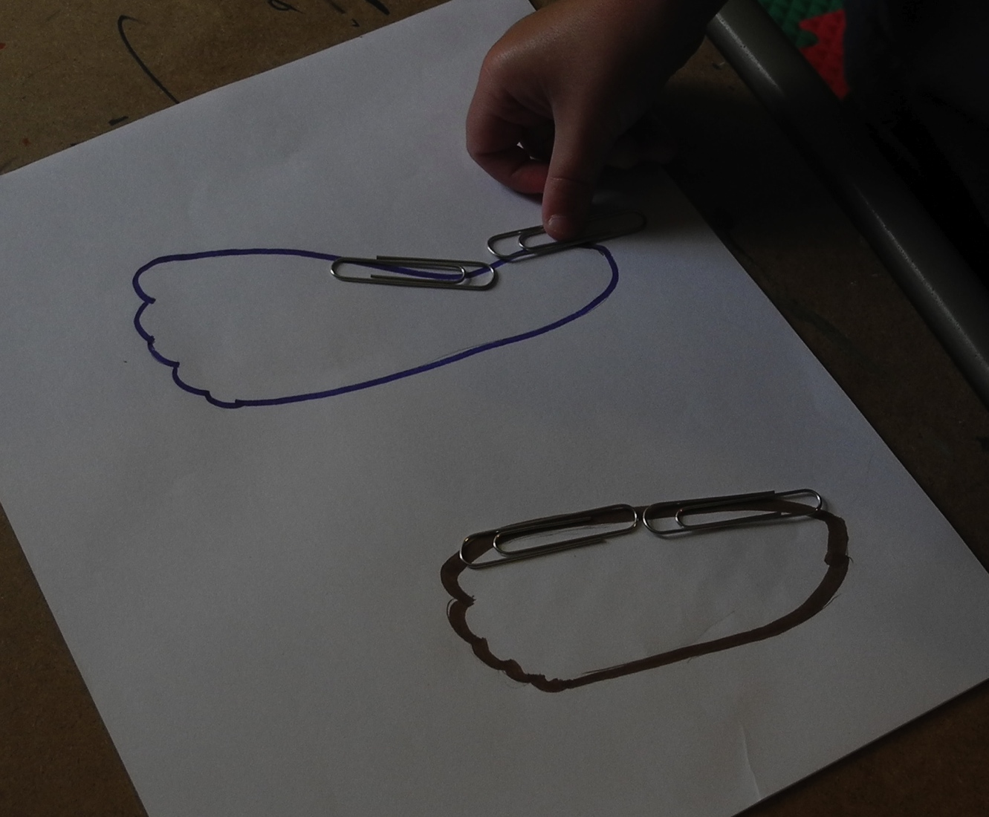
Activity: How big is your foot?
Who has the bigger foot?
What is the difference, in paper clips, between the two feet?
What adaptations, if any, are necessary for a student to access this activity?

Slide 4
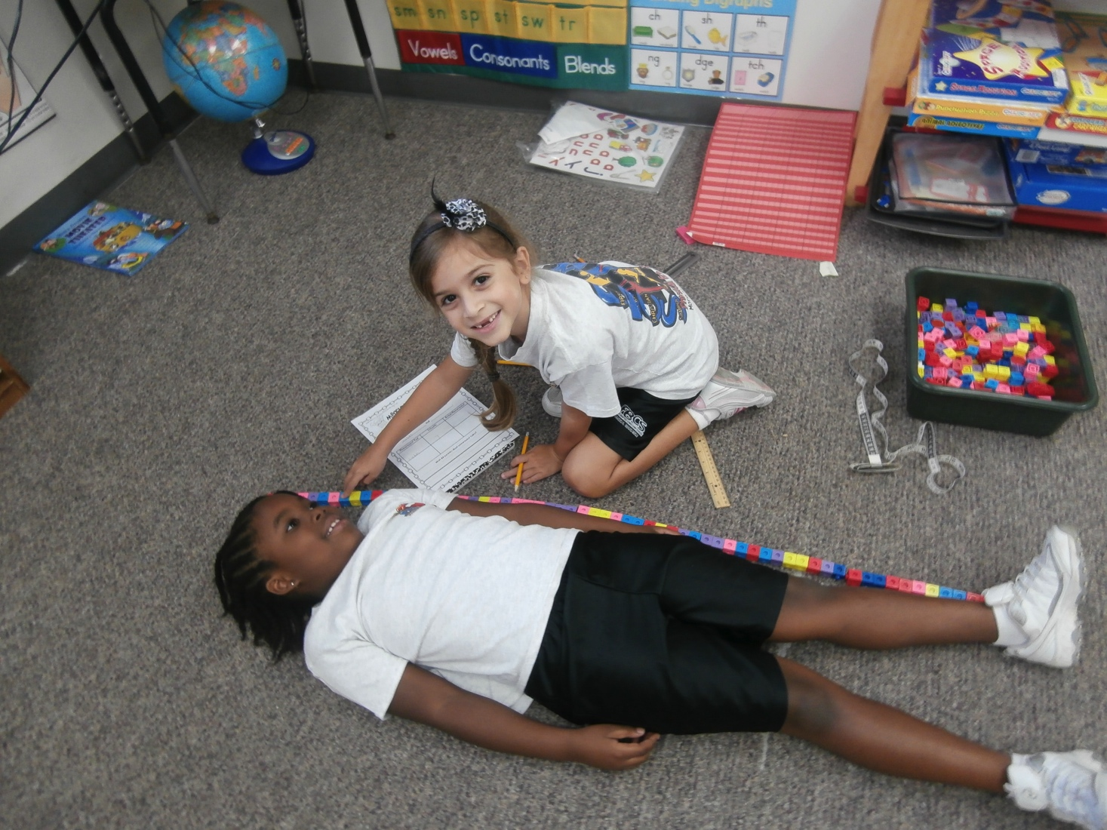
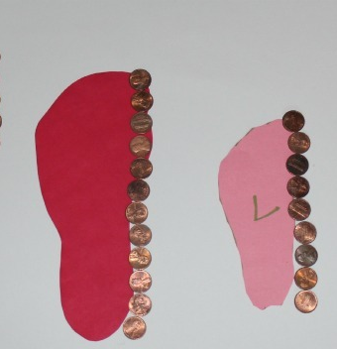
Alternate units for measuring

Slide 5
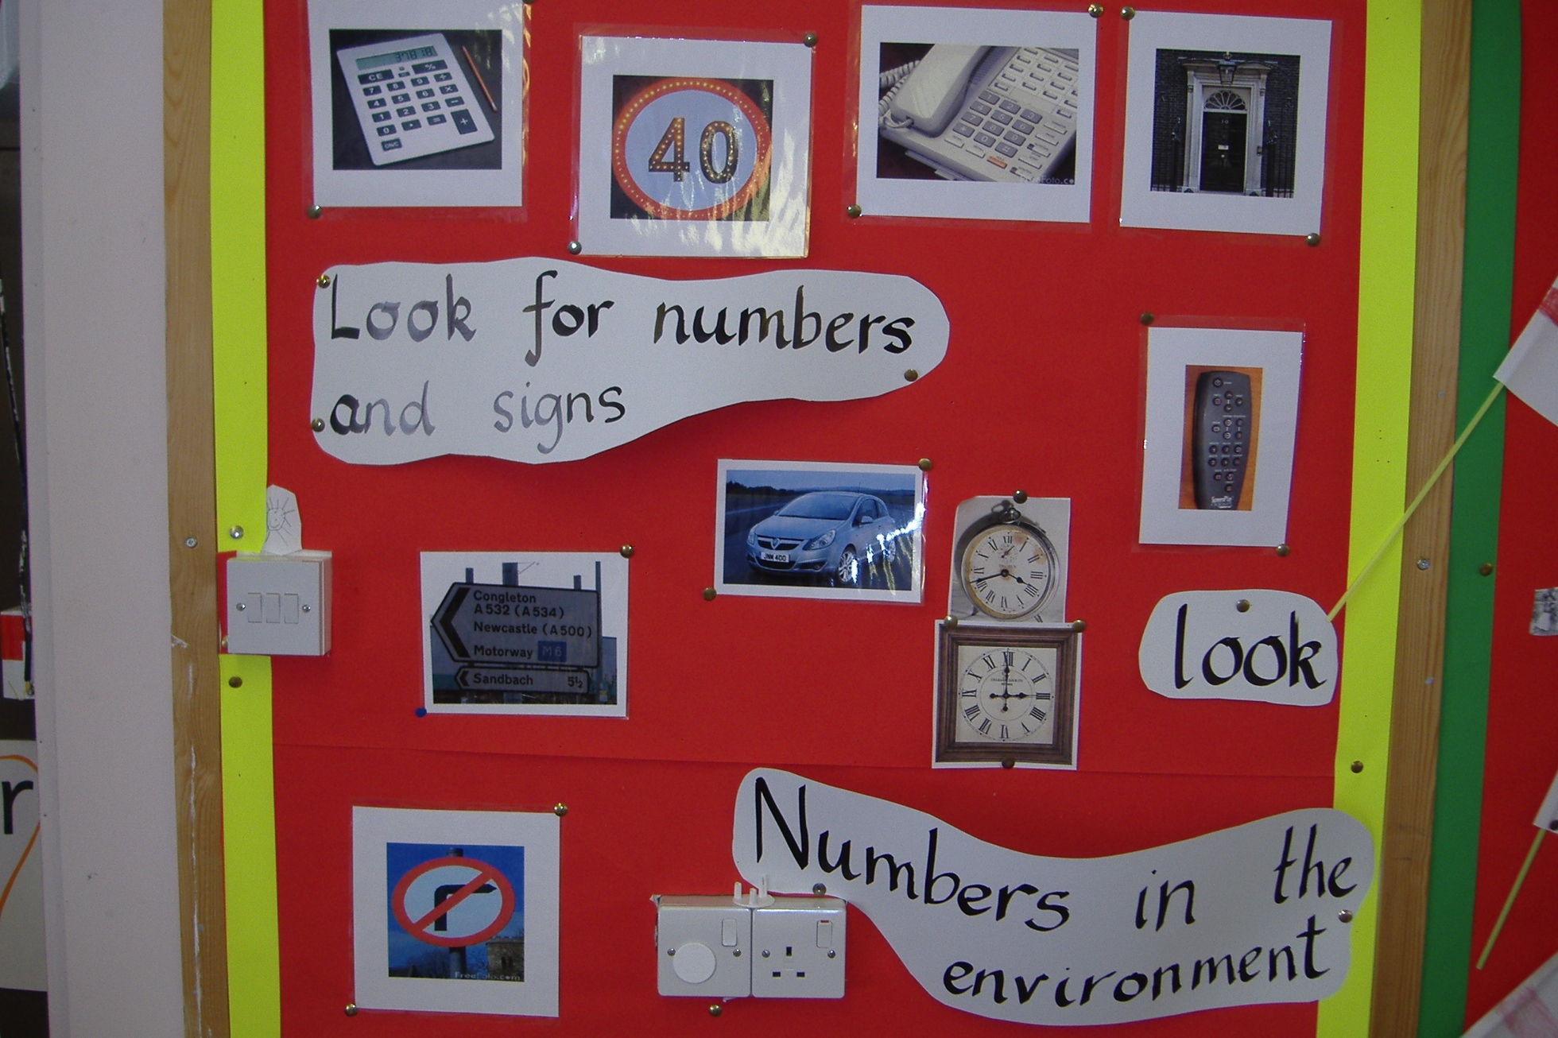
Environmental print

Slide 6
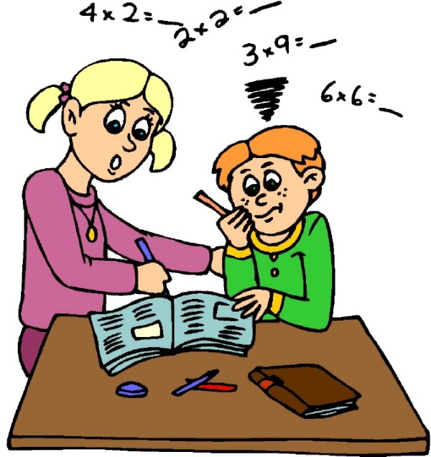
Adaptations – what we know

Slide 7
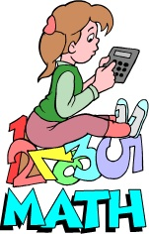
PLO Activity
Where is the PLO for this math function found?
What is effective about this approach?
What other adaptations might be necessary for students to access this PLO in the math curriculum?

Slide 8
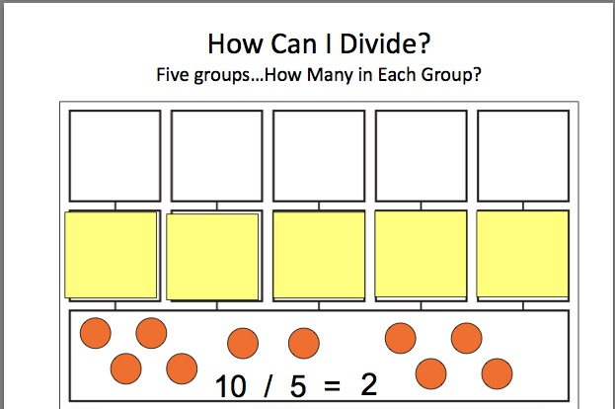
Division

Slide 9
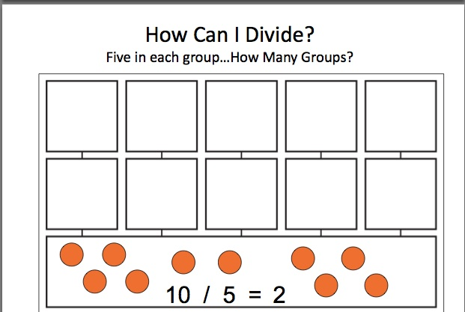
Division

Slide 10
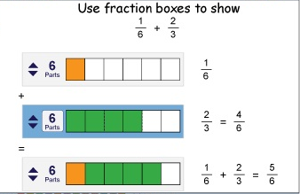
Fraction Boxes

Slide 11
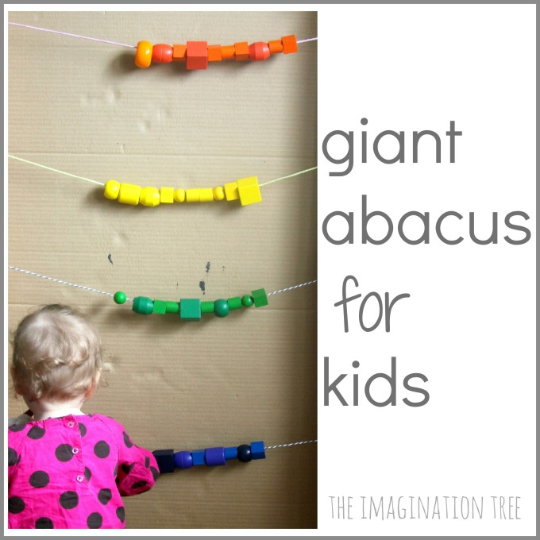
Kinesthetic Materials

Slide 12
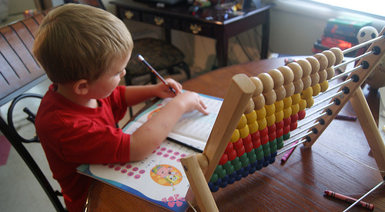
Desk top materials

Slide 13
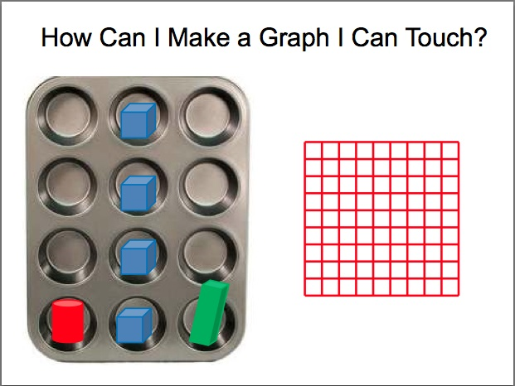
Graphing

Slide 14
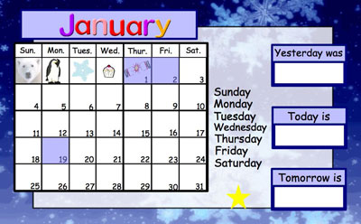
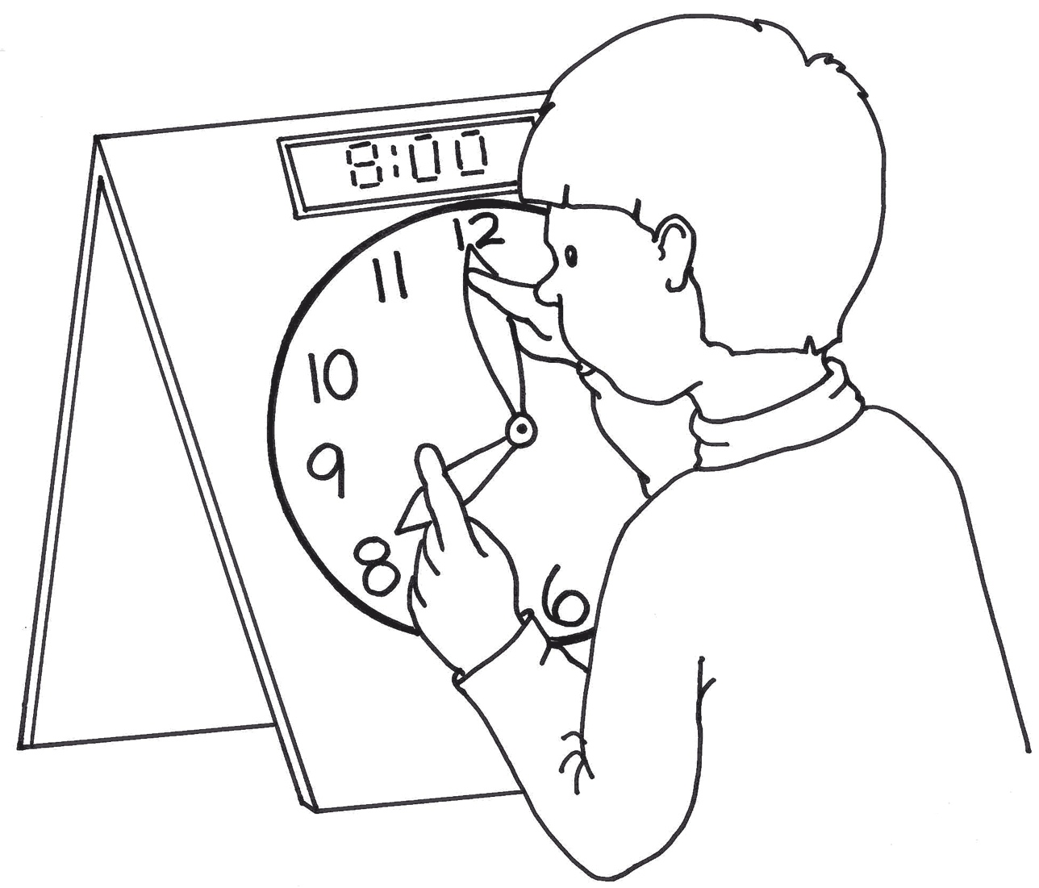
Time

Slide 15
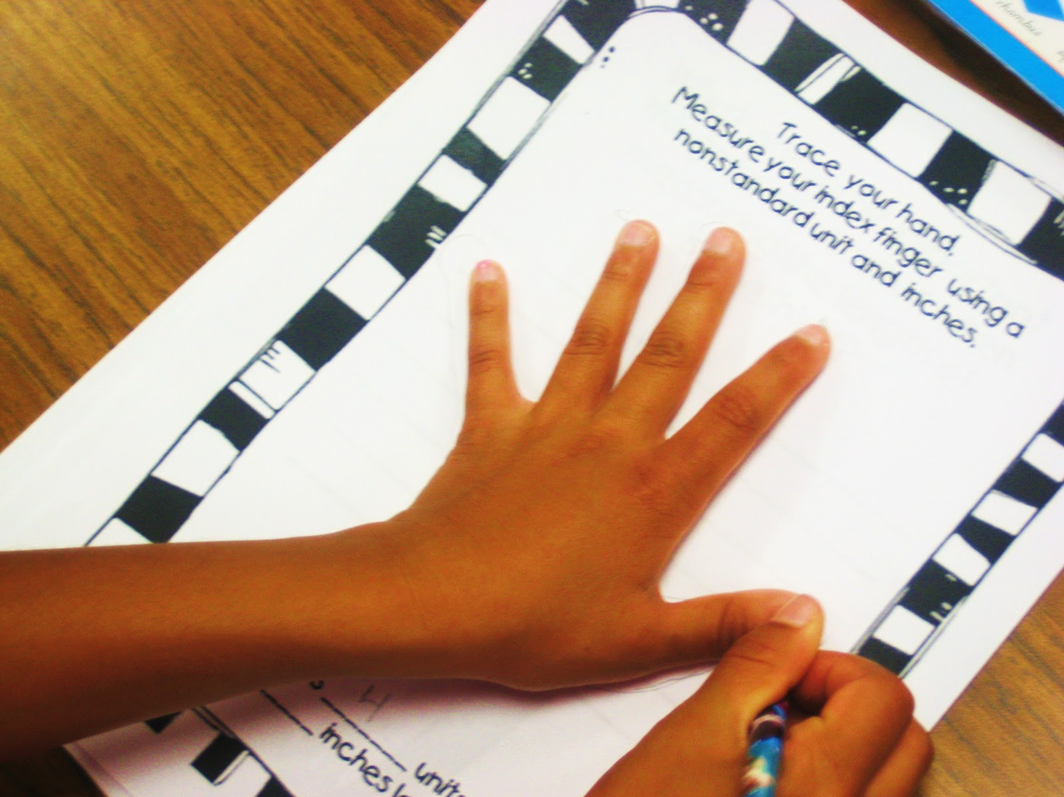
Measurement

Slide 16
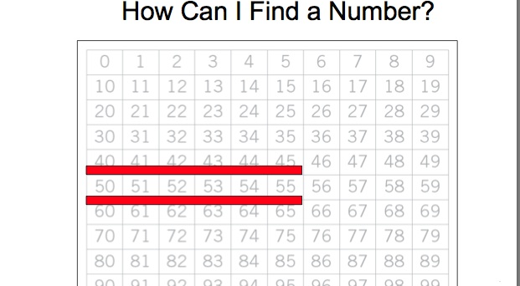
Numbers

Slide 17
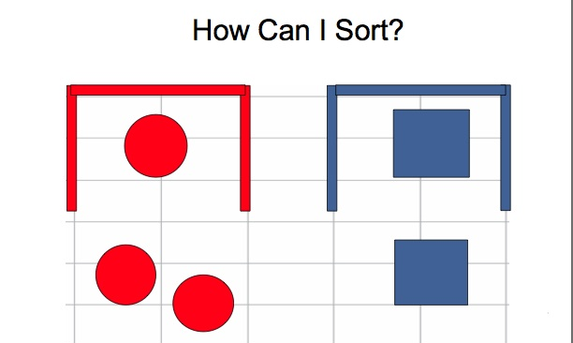
Sorting

Slide 18
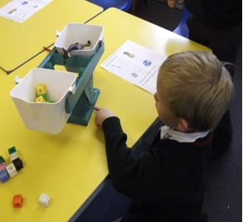
Problem solving

Slide 19
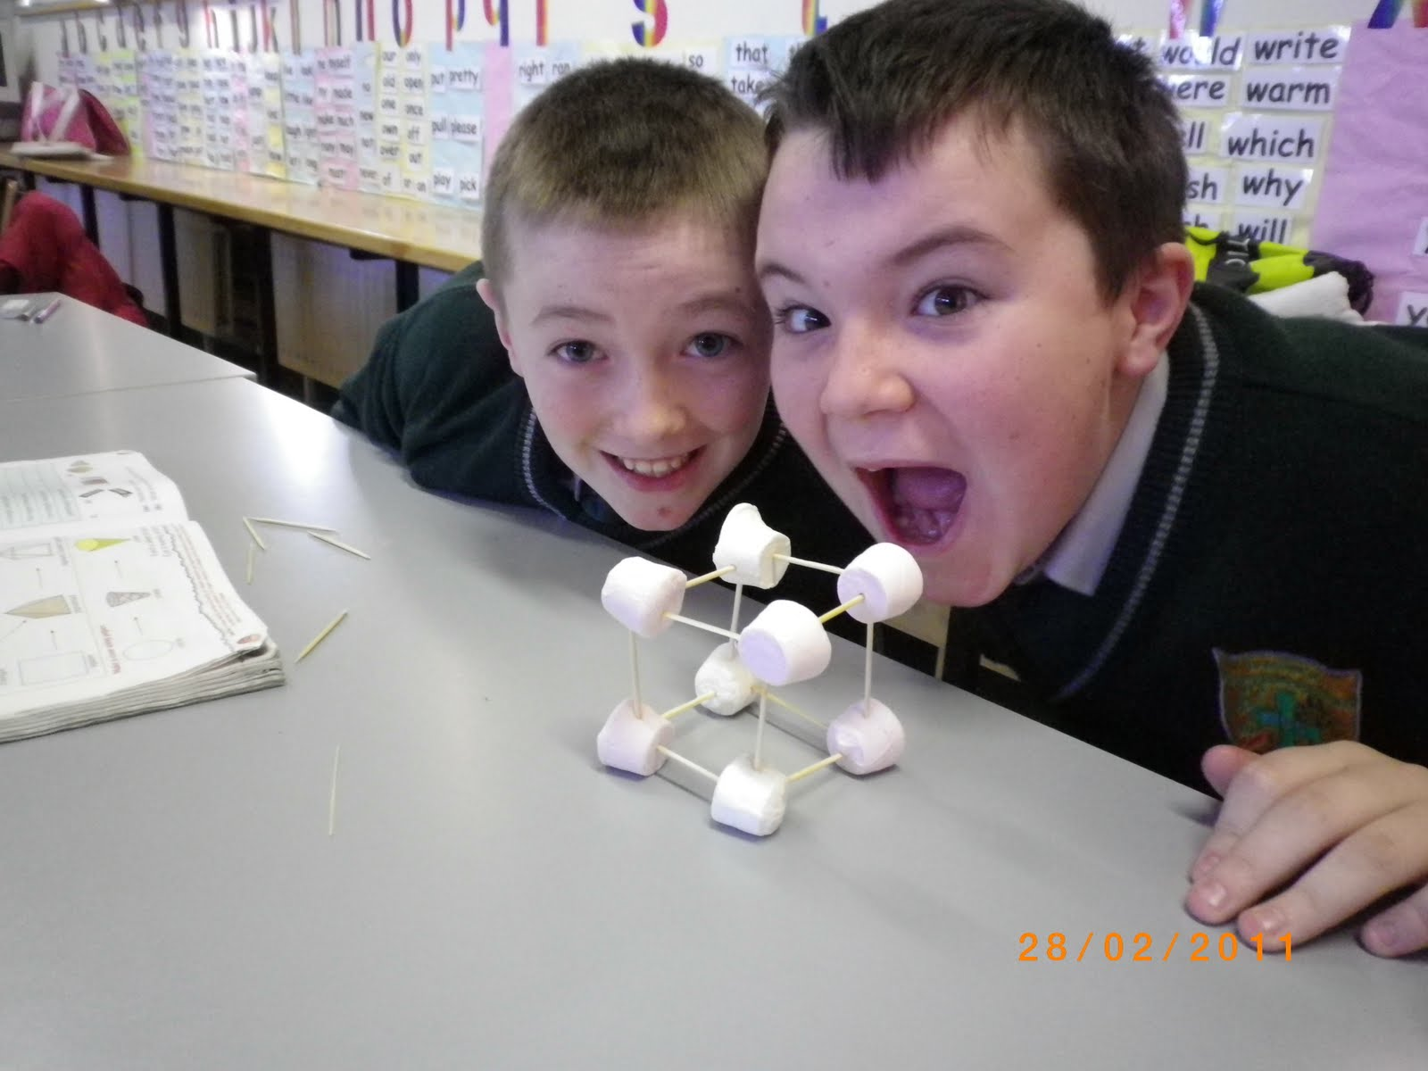
Building Objects

Slide 20
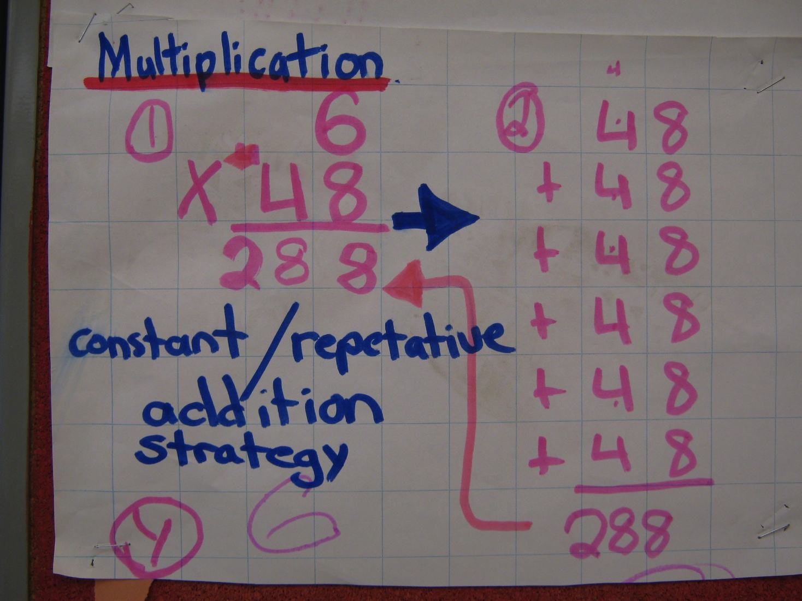
PLO for Mathematics
How can you use them to help with supporting access to the curriculum?
Who can help an EA with math supports?

Slide 21
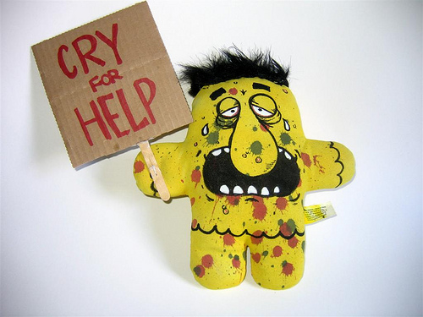
Math scares me! What can I do?
Who?
How?
Where?
When?

